Slide 1
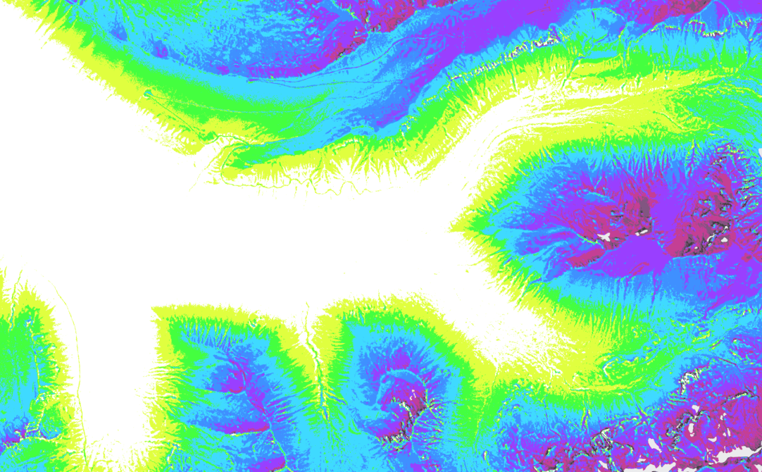
RMBL Spatial Data Science Webinar Series
Webinar 2: Study Design Using Geospatial Tools
Ian Breckheimer, PhD
RMBL Staff Research Scientist
@ibreckhe | ikb@rmbl.org

Slide 2
Webinar Schedule
RMBL Spatial Data Science Webinar Series

Slide 3
Outline
Why?
What?
How?
Why use geospatial tools to design field studies?
What foundational concepts do I need to know to design good field surveys?
What are some useful basic design paradigms?
How to use QGIS and R to select research sites

Slide 4
Good design is hard
Scientific validity:
-Proper scope
-Appropriate data structure
-Adequate sample size
-Acceptable measurement error
Logistical feasibility
-Adequate time and effort
-Safe and efficient access
-Good timing
-Few conflicting land uses
Notes:
In 2000 – 15 Major EO satellite platforms, 2010 – 43 platforms, 2020 – 80+

Slide 5


Slide 6


Slide 7
Good design is hard
Scientific validity:
-Proper scope
-Appropriate data structure
-Adequate sample size
-Acceptable measurement error
Logistical feasibility
-Adequate time and effort
-Safe and efficient access
-Good timing
-Few conflicting land uses
Notes:
In 2000 – 15 Major EO satellite platforms, 2010 – 43 platforms, 2020 – 80+

Slide 8
Generalization - a sticky issue
Notes:
In 2000 – 15 Major EO satellite platforms, 2010 – 43 platforms, 2020 – 80+

Slide 9
Outline
Why?
What?
How?
Why use geospatial tools to design field studies?
What foundational concepts do I need to know to design good field surveys?
What are some useful basic design paradigms?
How to use QGIS and R to select research sites

Slide 10
4 Key Concepts for Study Design
Study Area and Sampling Frame – What is the population from which my samples are drawn?
Sample Size and Power – How can I make sure my results are as precise as possible?
Representativeness and Coverage – What are the most important features of a sample for inference?
Spatial Autocorrelation – How important is it that my sites are independent?

Slide 11
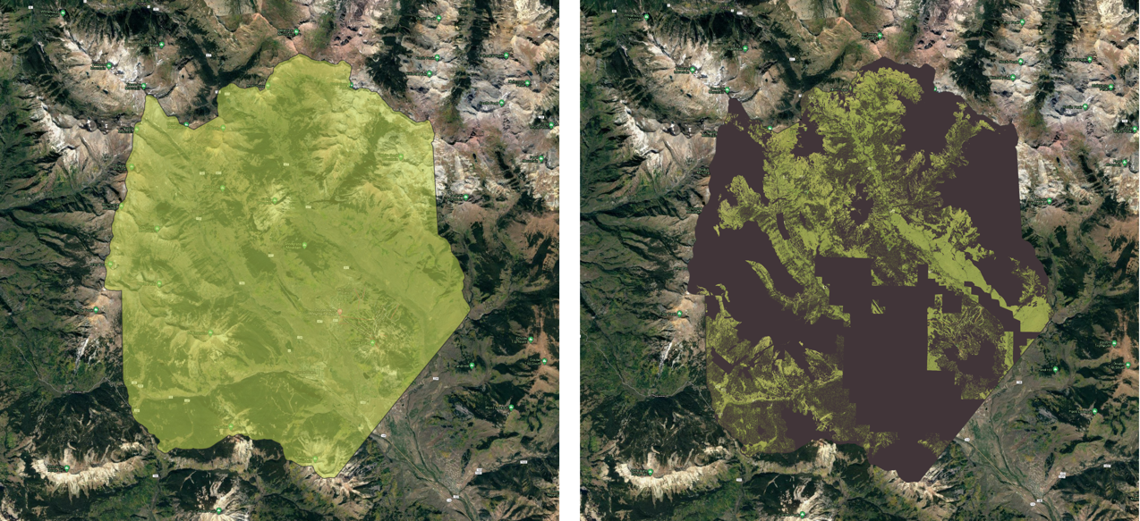
Study Area & Sampling Frame
Study Area
Sampling Frame
Collection of all sites
that could be sampled
Where a study was done

Slide 12
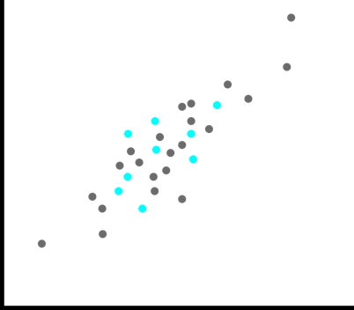
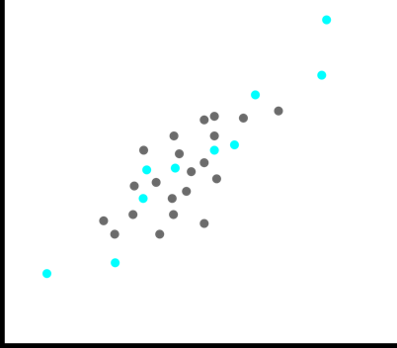
Sample Size and Statistical Power
y
y
x
Hale et al. 2012 DOI: 10.1371/journal.pone.0045170

Slide 13
Representativeness and Feature Coverage
Representativeness
Feature Coverage
The degree to which the sample reflects the characteristics of the sampling frame or population.
The degree to which the sample reflects the full range of variability in the sampling frame.
y
y
x
x
Good representativeness, low coverage
Good coverage, poor representativeness

Slide 14
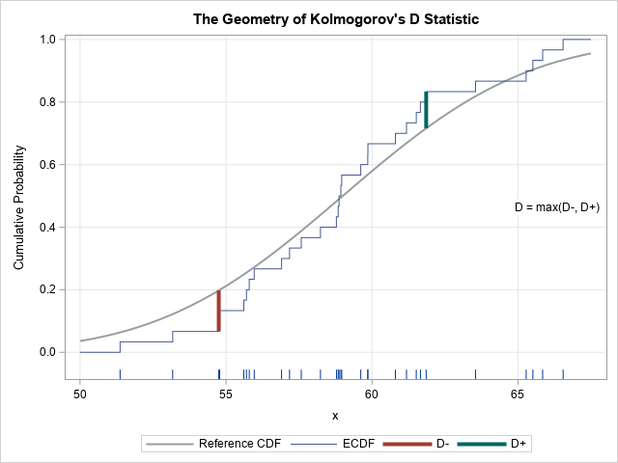
Measuring Representativeness
Kolmogorov’s D

Slide 15
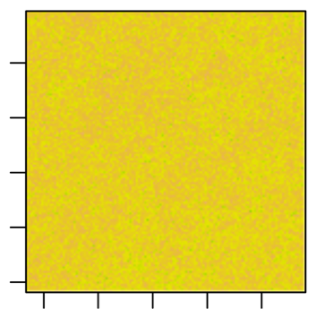
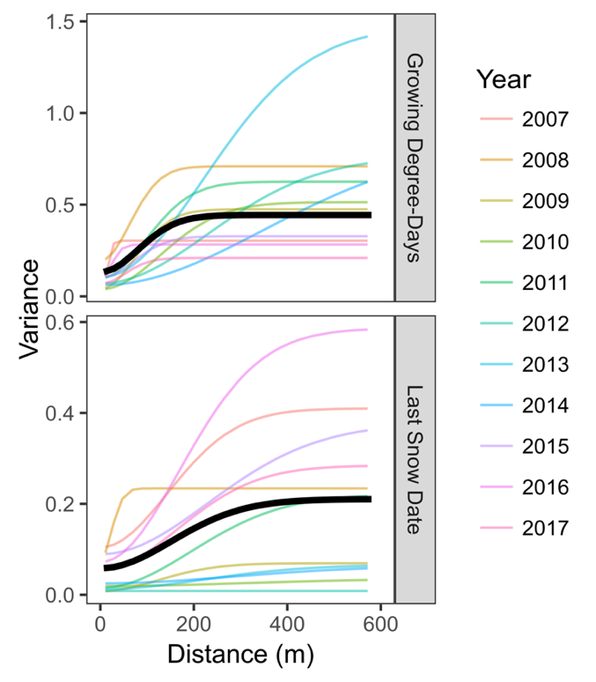
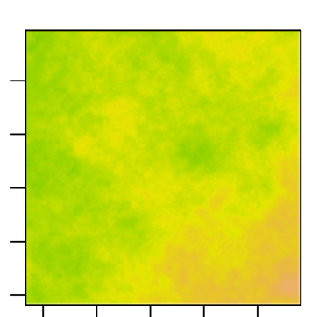
Spatial Autocorrelation (smoothness)
Growing Degree-Days
Last Snow Date

Slide 16
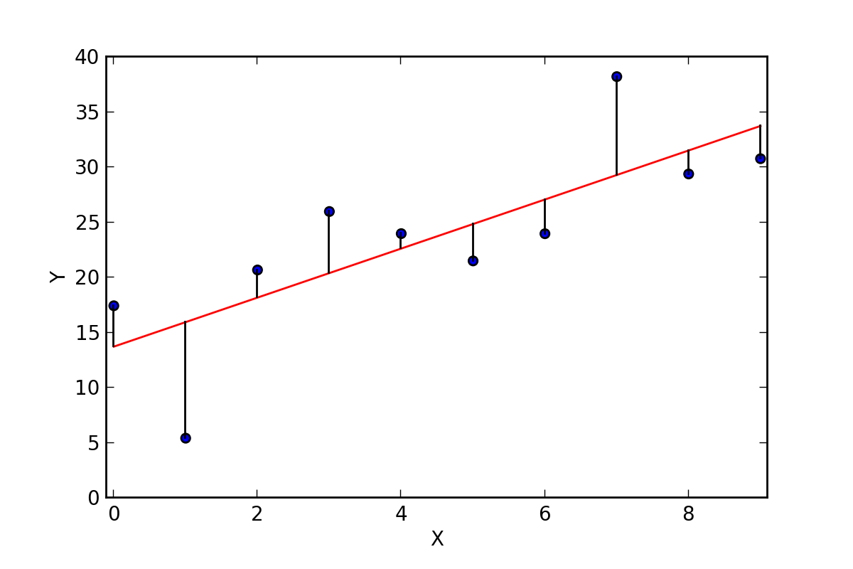
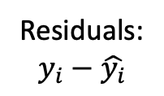
When is spatial autocorrelation a problem?
Generally, this is only a problem for inference when there is
autocorrelation in the residuals from a statistical model.
Residuals:
$$y_{i}−\hat{y_{i}}$$

Slide 17
Outline
Why?
What?
How?
Why use geospatial tools to design field studies?
What foundational concepts do I need to know to design good field surveys?
What are some useful basic design paradigms?
How to use QGIS and R to select research sites

Slide 18
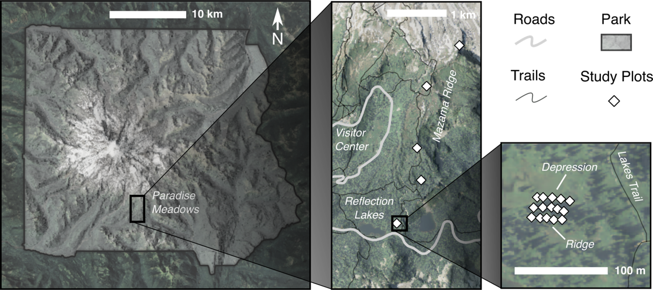
Manual vs semi-automated site selection
An Example of Manual Site Selection

Slide 19
Tools for manual site selection
RMBL Online Research Map
Desktop GIS
https://rmbl.maps.arcgis.com/apps/View/index.html?appid=f79d76dbeec144518cc46dddd3bf95ac
RMBL Research sites URI: ﻿https://services8.arcgis.com/jOS5YDdMN6EQxI1b/arcgis/rest/services/RMBLResearchSites_Public/FeatureServer

Slide 20

Drawbacks of manual site selection
Our brains are not set up to select representative samples.
…especially in 3+ dimensions.

Slide 21
Drawbacks of manual site selection
The sampling frame is ambiguous.

Slide 22
(semi)automated Site Selection
Simple random sampling.
Stratified random sampling.
Latin hypercube sampling.
Others: Geographic tessellations, faceted clusters.

Slide 23
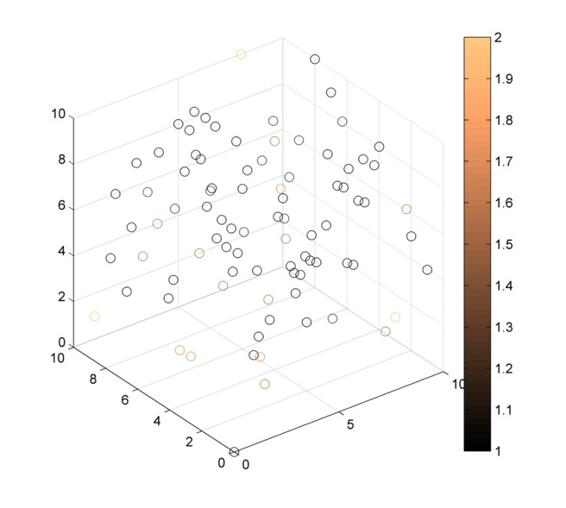
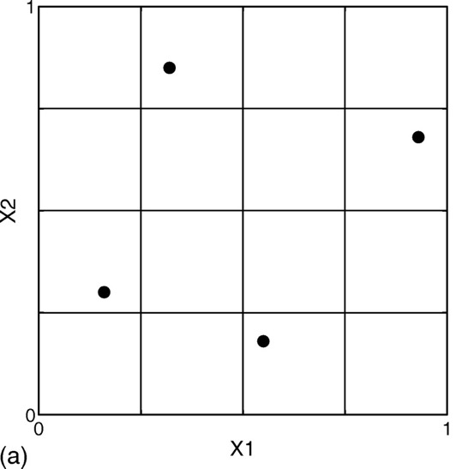
Latin Hypercube Sampling
Latin Square, 2d
Latin Cube, 3d
Latin Square
Vamvatsikos et al. 2014 https://doi.org/10.1061/(ASCE)ST.1943-541X.0001030

Slide 24

Latin Hypercube Sampling
y
x
Maximizes coverage, at the cost of representativeness

Slide 25
Demo: Exploring sampling designs in R

Slide 26
Thanks!
Contact Me:
Ian Breckheimer
ikb@rmbl.org
Twitter, Github: @ibreckhe

